Slide 1
Meeting 20220302
Joren Janzing

Slide 2
Composite Maps

Slide 3
Method
Initial approach:
Select: few years in detrended melt time series.
Read: only relevant years
+ saves time
- no running mean possible
Detrend with monthly mean of 1 full ensemble member.
+ saves time
- no detrending, difference between ensemble means are exaggerated.
Select all values which corresponds to x months before detection.
New approach:
Select: only few years in detrended melt time series.
Read: Load and detrend all data. Select relevant years
Optional: Apply running mean.
Detrend with monthly mean of 1 full ensemble member.
Select all values which corresponds to x months before detection.

Slide 4
Questions
Detected by centered 24 month mean→ should I also look at 24 month rolling means in the plots?
What reference to use?

Slide 5
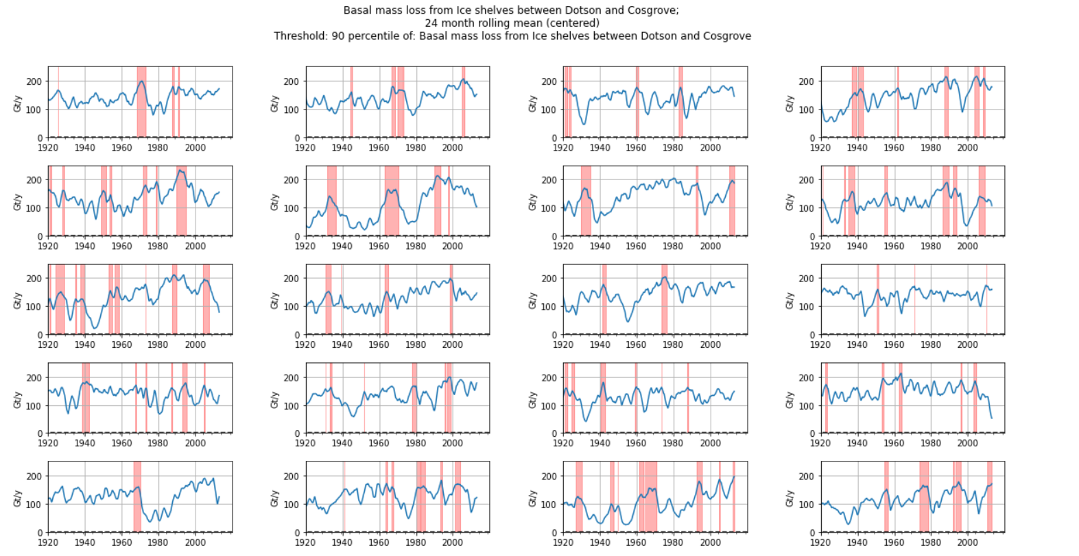

Slide 6
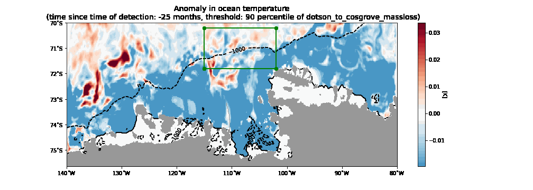

Slide 7
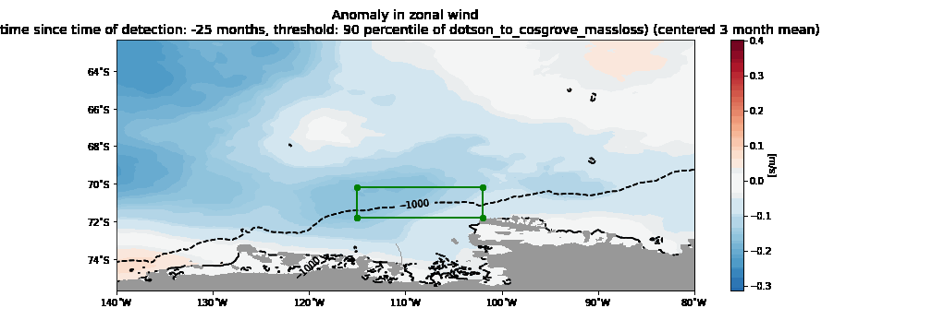

Slide 8
Correlation Maps

Slide 9
Method
Read data and separate time series
Detrend it by applying 25 year running mean.
Find optimal lag by only looking at precomputed time series (saves time).
Make one time series with all ensemble members sequentially.
Remove all values with NaNs and the corresponding indices in other timeseries. NaNs arise from rolling mean or from shifting the time series by the optimal lag.
Compute Pearson r.

Slide 10
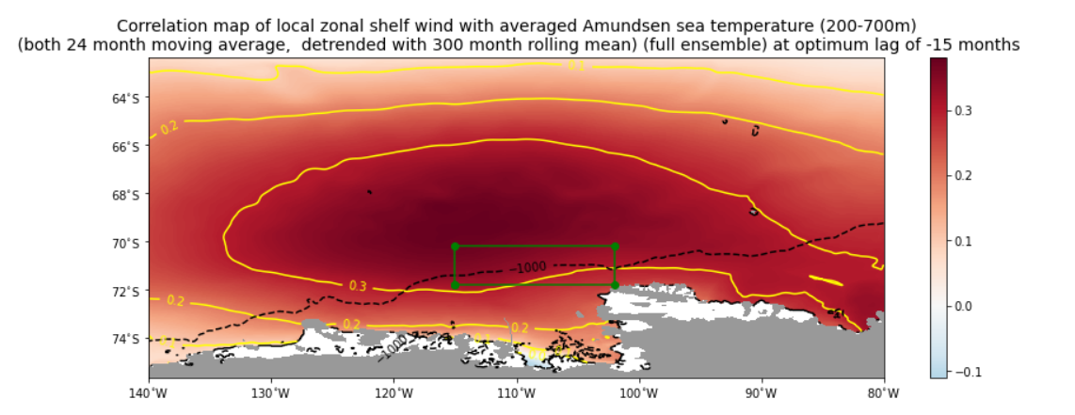

Slide 11
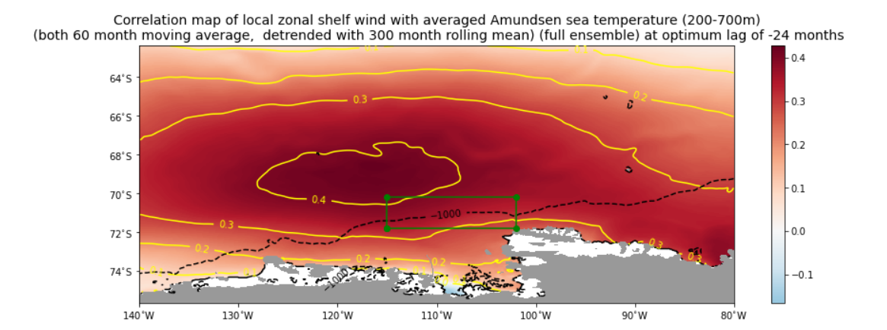
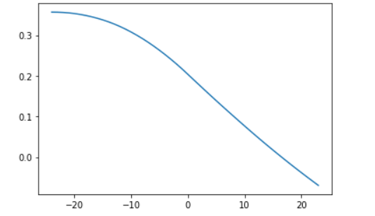

Slide 12
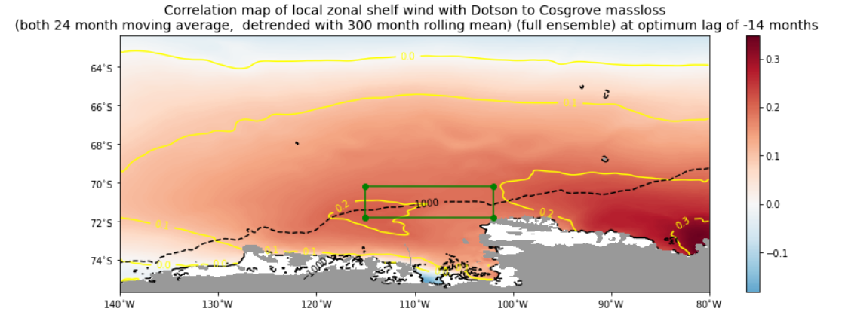

Slide 13
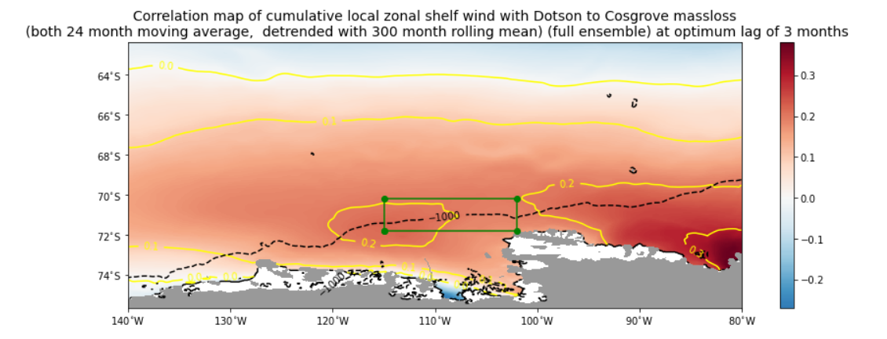
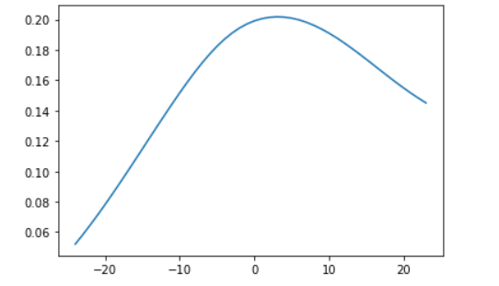

Slide 14
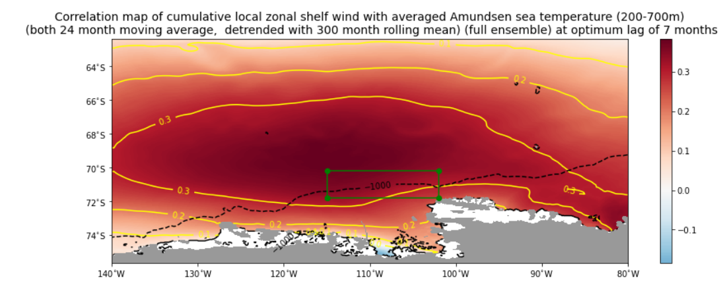

Slide 15
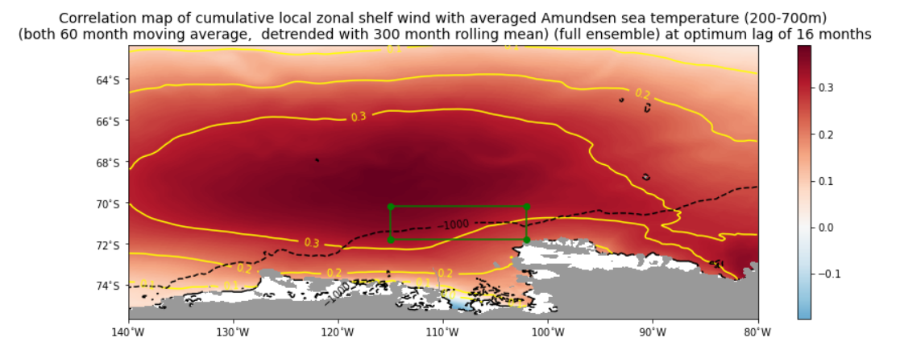

Slide 16
What happened here?

Slide 17
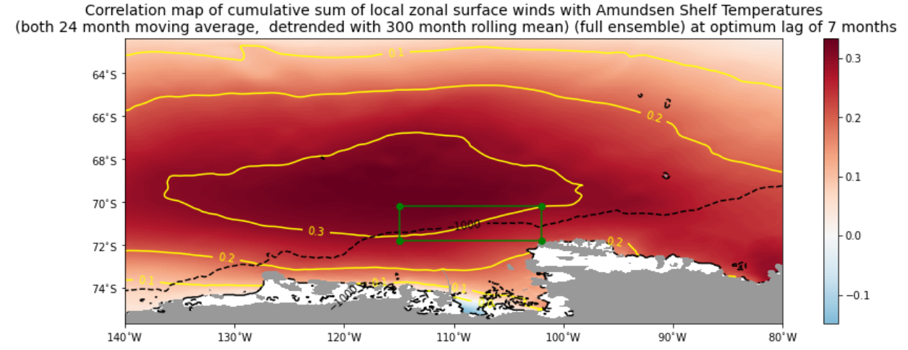

Slide 18
